Slide 1

Customer App
Onderdeel van RigS

Slide 2


Inhoud
Sprint planning
Documentatie
Wireframes
High level designs
Demo
Planning sprint 2

Slide 3

Sprint Planning
FR08 Guest can select the number of products they need.
FR11 Guest can place an order for selected products.
FR12 Guest can view all the products that are in their order.
FR13 Guest can remove products from their order (before confirming)
FR25 Guest can view all products on the menu

Slide 4


Documentatie
Functional document
Design document

Slide 5
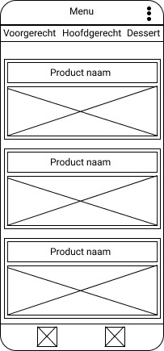
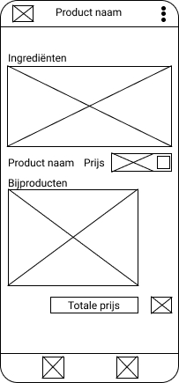
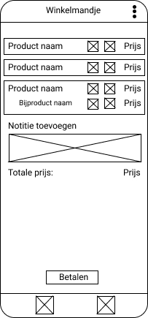
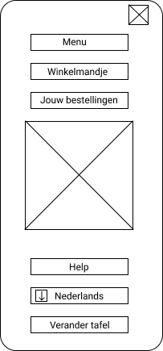
Wireframe 1

Slide 6
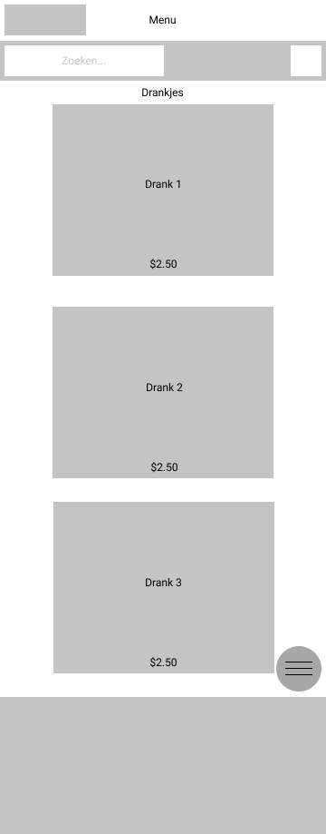
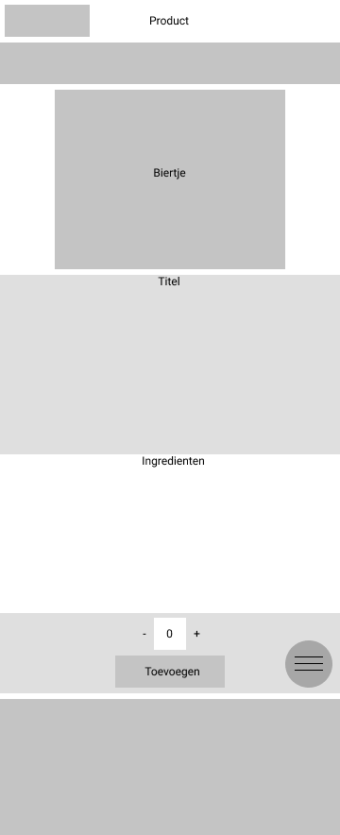
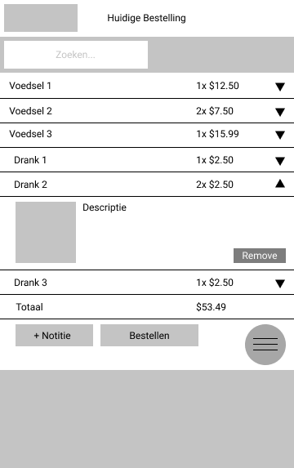
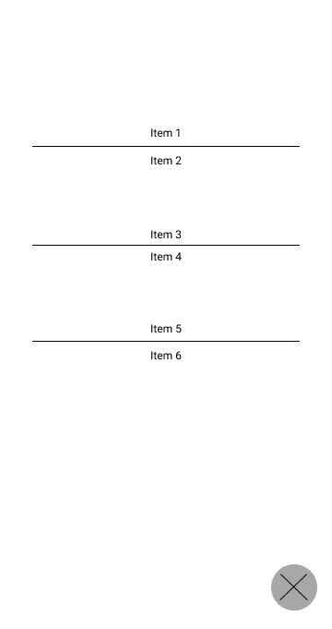
Wireframe 2

Slide 7
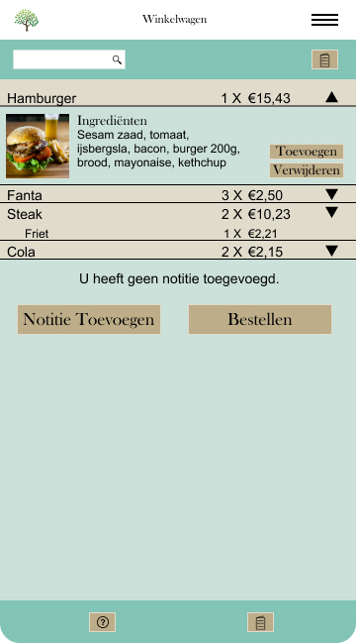
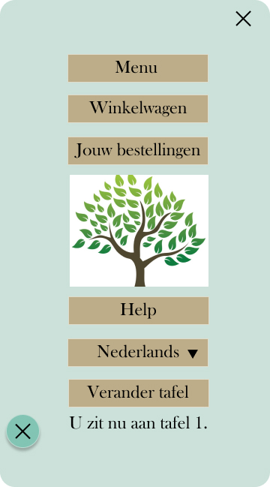
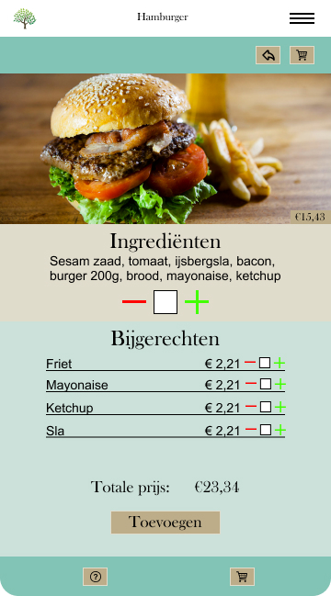
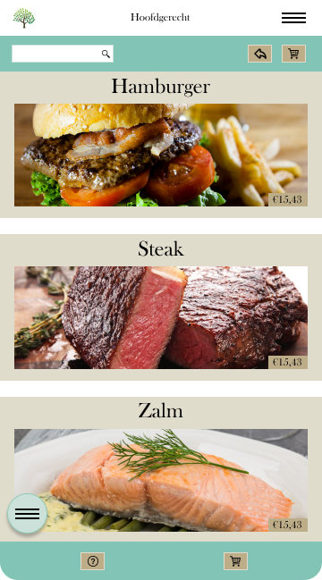
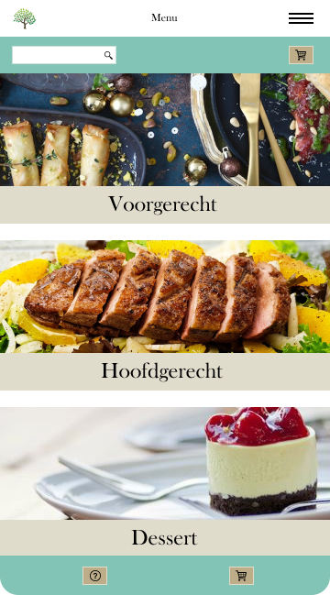
High level designs

Slide 8


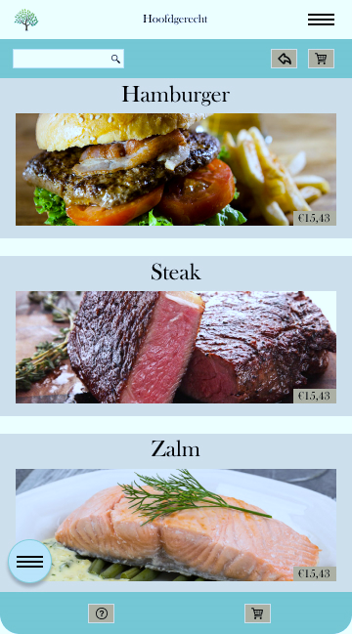
Demo

Slide 9

Planning Sprint 2
FR01 Guest can scan the QR code to start placing their order (they go to the website with the correct table when scanning the code).
FR17 Guest can view all his/her ordered products.

